Slide 1
Saving and Serializing
Reading and Writing Java to CSV

Slide 2
Why save to file?
Keep information persistent even after game is closed
Use same accounts when changing computers

Slide 3
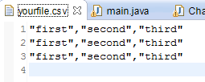
Comma Separated Values format
Every entry separated by commas
Every row separated by newline
Empty line to indicate end of file

Slide 4
Using OpenCSV library
Download OpenCSV at http://sourceforge.net/projects/opencsv/
Put jar file in project folder
Right click project in eclipse > Build path > Configure build Path
Libraries > add JARs > select OpenCSV jar file

Slide 5
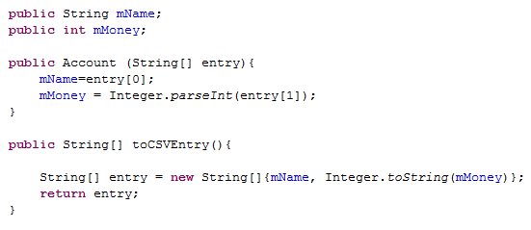
Preparing an Object for CSV

Slide 6
OpenCSV demo

Slide 7
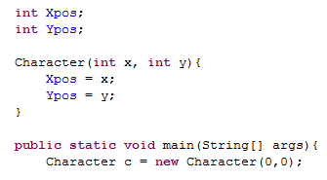

What is Serialization
Saves the state of an instance into a byte stream

Slide 8



How to Serialize
Make class implement Serializable
All classes within a Serializable class must be Serializable

Slide 9
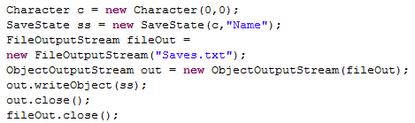
How to Serialize
Save to file

Slide 10
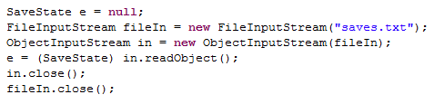
How to Deserialize

Slide 11
Serialization Demo

Slide 12
Pitfalls of Serializing
Reduces flexibility to change code
Adding new fields
Changing code can break tests, must test for serializability

Slide 13
References
Item 74 pitfalls of Serialization: http://uet.vnu.edu.vn/~chauttm/e-books/java/Effective.Java.2nd.Edition.May.2008.3000th.Release.pdf
Serialization tutorial: http://www.tutorialspoint.com/java/java_serialization.htm
OpenCSV: http://opencsv.sourceforge.net/

